Slide 1
THE UNENCUMBERED GENE ASSOCIATION OF MOLECULAR PATHOLOGY v. U.S.P.T.O
Debra Greenfield, J.D. Adjunct Assistant Professor
UCLA Center for Society & Genetics

Slide 2
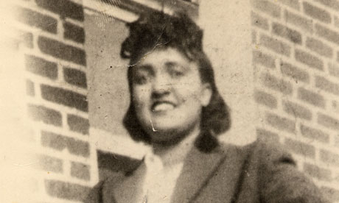
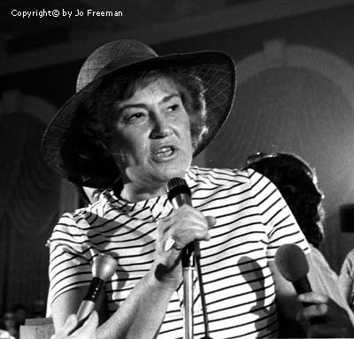
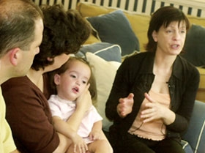

Slide 3
“As genes play an increasingly powerful role in contemporary legal and political culture, individuals are called upon to refer to genetic information as a basis for asserting their rights and duties. In this context, to know your rights, you must first know your genes…”
Jonathan Kahn, What’s the Use? Law and Authority in Patenting Human Genetic Material, Stanford Law & Policy Review, Volume 14.2 200

Slide 4
“It’s the three dimensional configuration of the molecule that encodes the information….no one is interested in the strings of human-readable letters, they are instead interested in what can be done with the structures the letters represent… and that in turn means that by necessity they must be interested in building informational structures-the molecules that are the conduit for information transfer. Thus, “it is the information flow that is of interest in biotechnology, and hence of interest in biotechnology patenting….”
Dan Burk, The Problem of Process in Biotechnology, 43 Hous. L. Rev. 561, 582-87 (2006).

